Slide 1
Networking Chat Application

Slide 2


Networking by using Server Socket and Socket
Person 1 Person 2
SeverSocket Socket
Step 1 ) first person 1 will open Step 2) then person 2 will enter a
a port so that connection the same port number as opened
can be established with that port by person 1 and the ipaddress of
person 1 and connection will be
established

Slide 3
Requirements:
Systems should be connected over the same network is the only
requirement

Slide 4
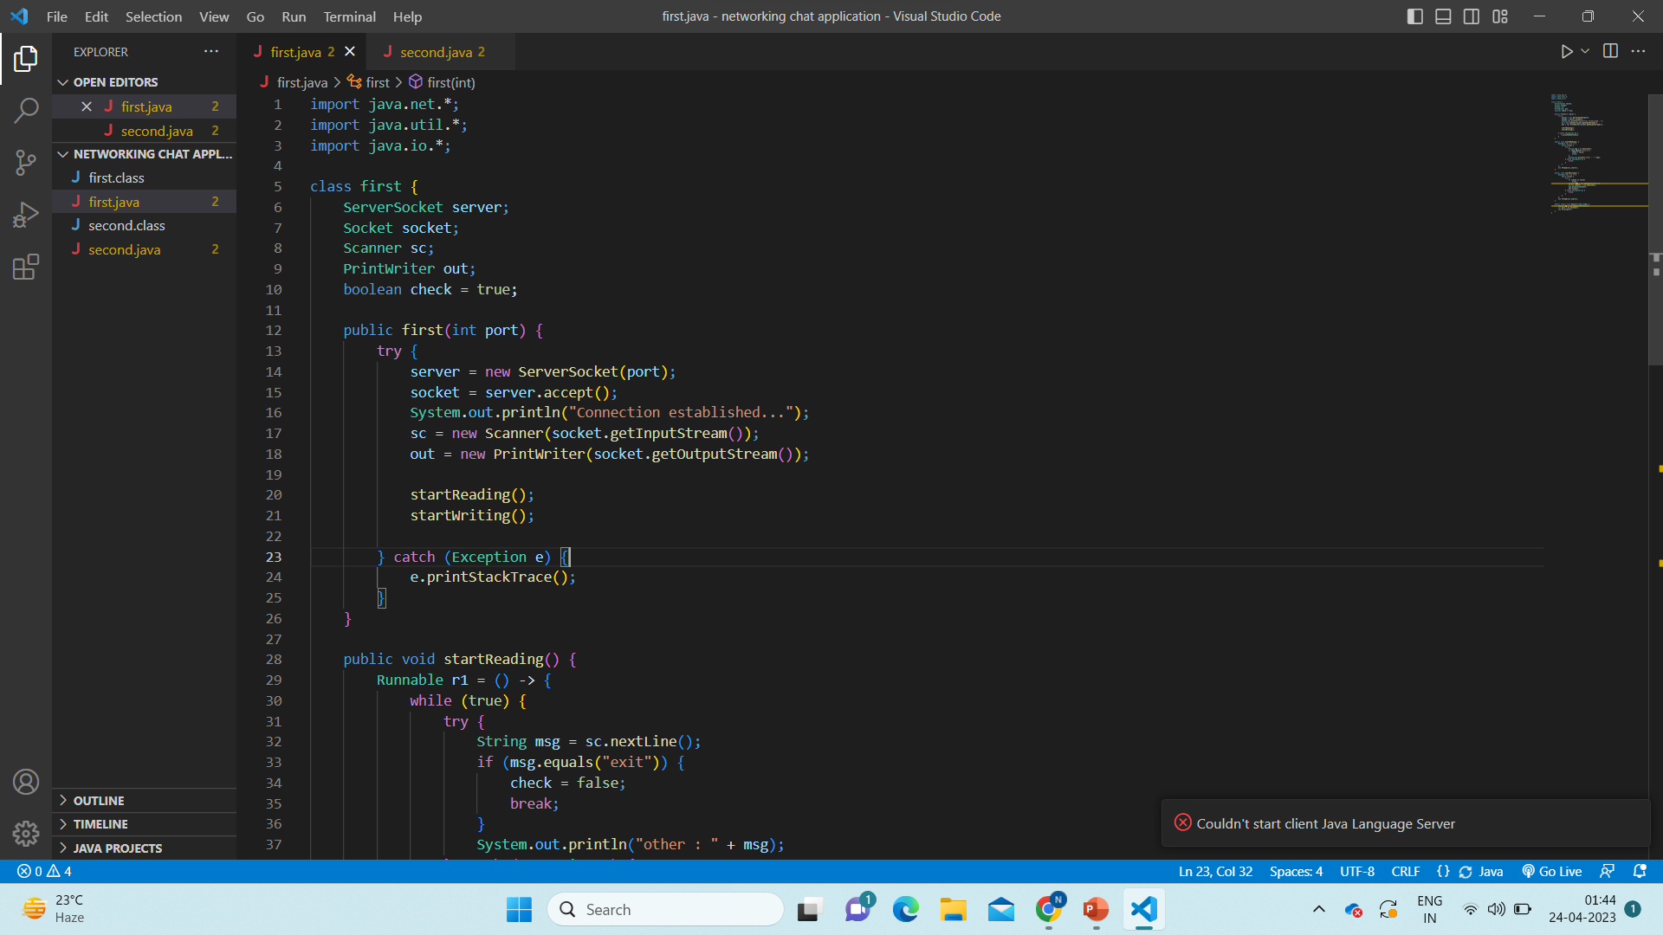
Code: Person 1

Slide 5
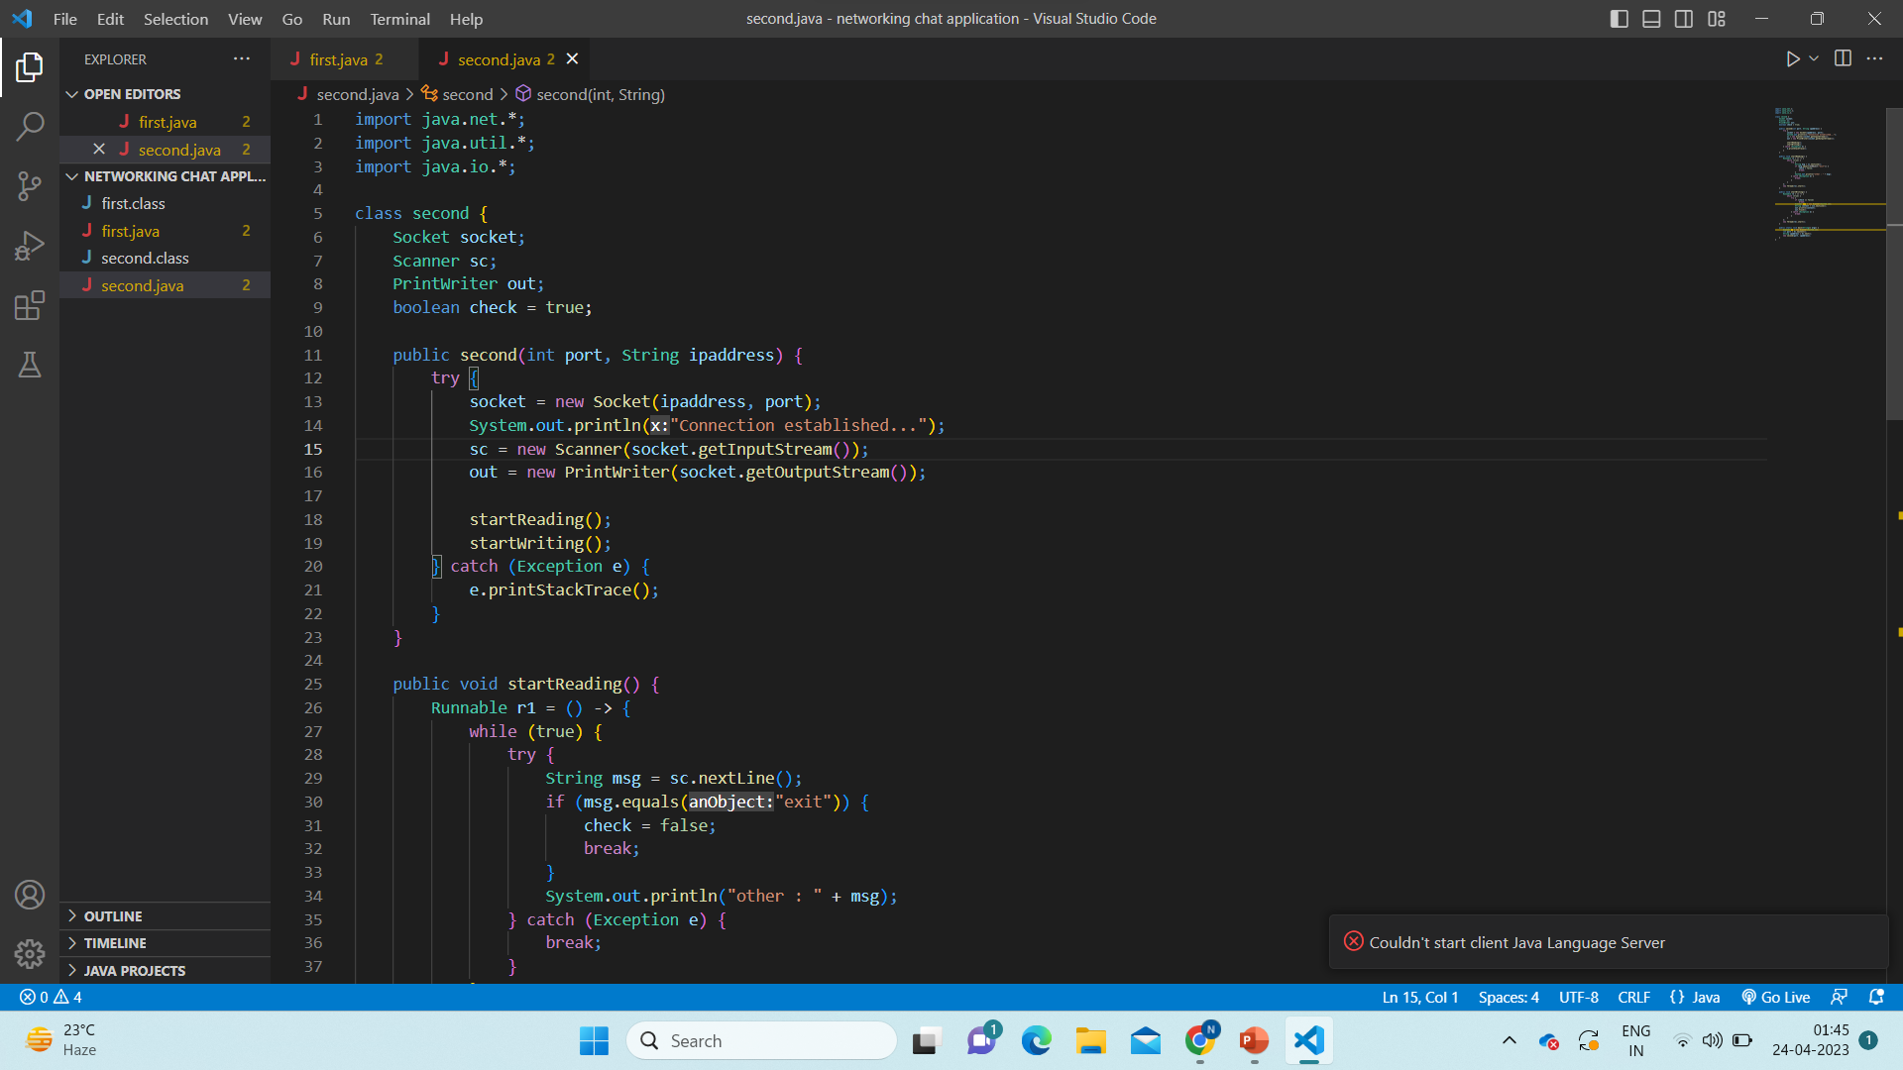
Code : Person 2

Slide 6
THANK YOU !!
Submitted by : Naman Dwivedi
(2000290110099)

